Slide 1
Women in Economics: Basic Understanding
SHARMIND NEELORMI
Department of Economics
Jahangirnagar University
neelormi1@yahoo.com

Slide 2
Meaning of Gender
Sex refers to biological differences between ♀♂
Gender refers to the socially determined personal and psychological characteristics associated with being ♀♂ (what's about 3rd Gender?) namely masculinity and femininity. Notion of masculinity and femininity historically, socially and culturally constructed.
Gender as analytical framework helps us to denaturalize (look beyond the nature) men and women, masculinity and femininity; to see them as socially produced not given by birth, thus different through time and place. It helps us to analyze relations of power of dominance and marginalization, hegemony and subjugation, hierarchy oppression as productive of gender identities, ideologies and practices. It helps us to look at knowledge and experiences of being a women or men as social practice, linked to power.

Slide 3
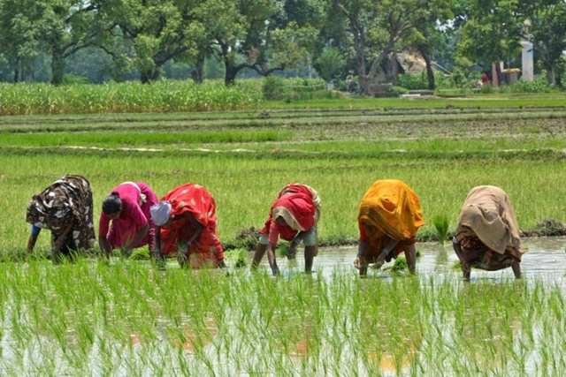
Women in Rural Economy: Bangladesh context
Sharmind Neelormi
Associate Professor, Department of Economics
Jahangirnagar University
neelormi1@yahoo.com

Slide 4
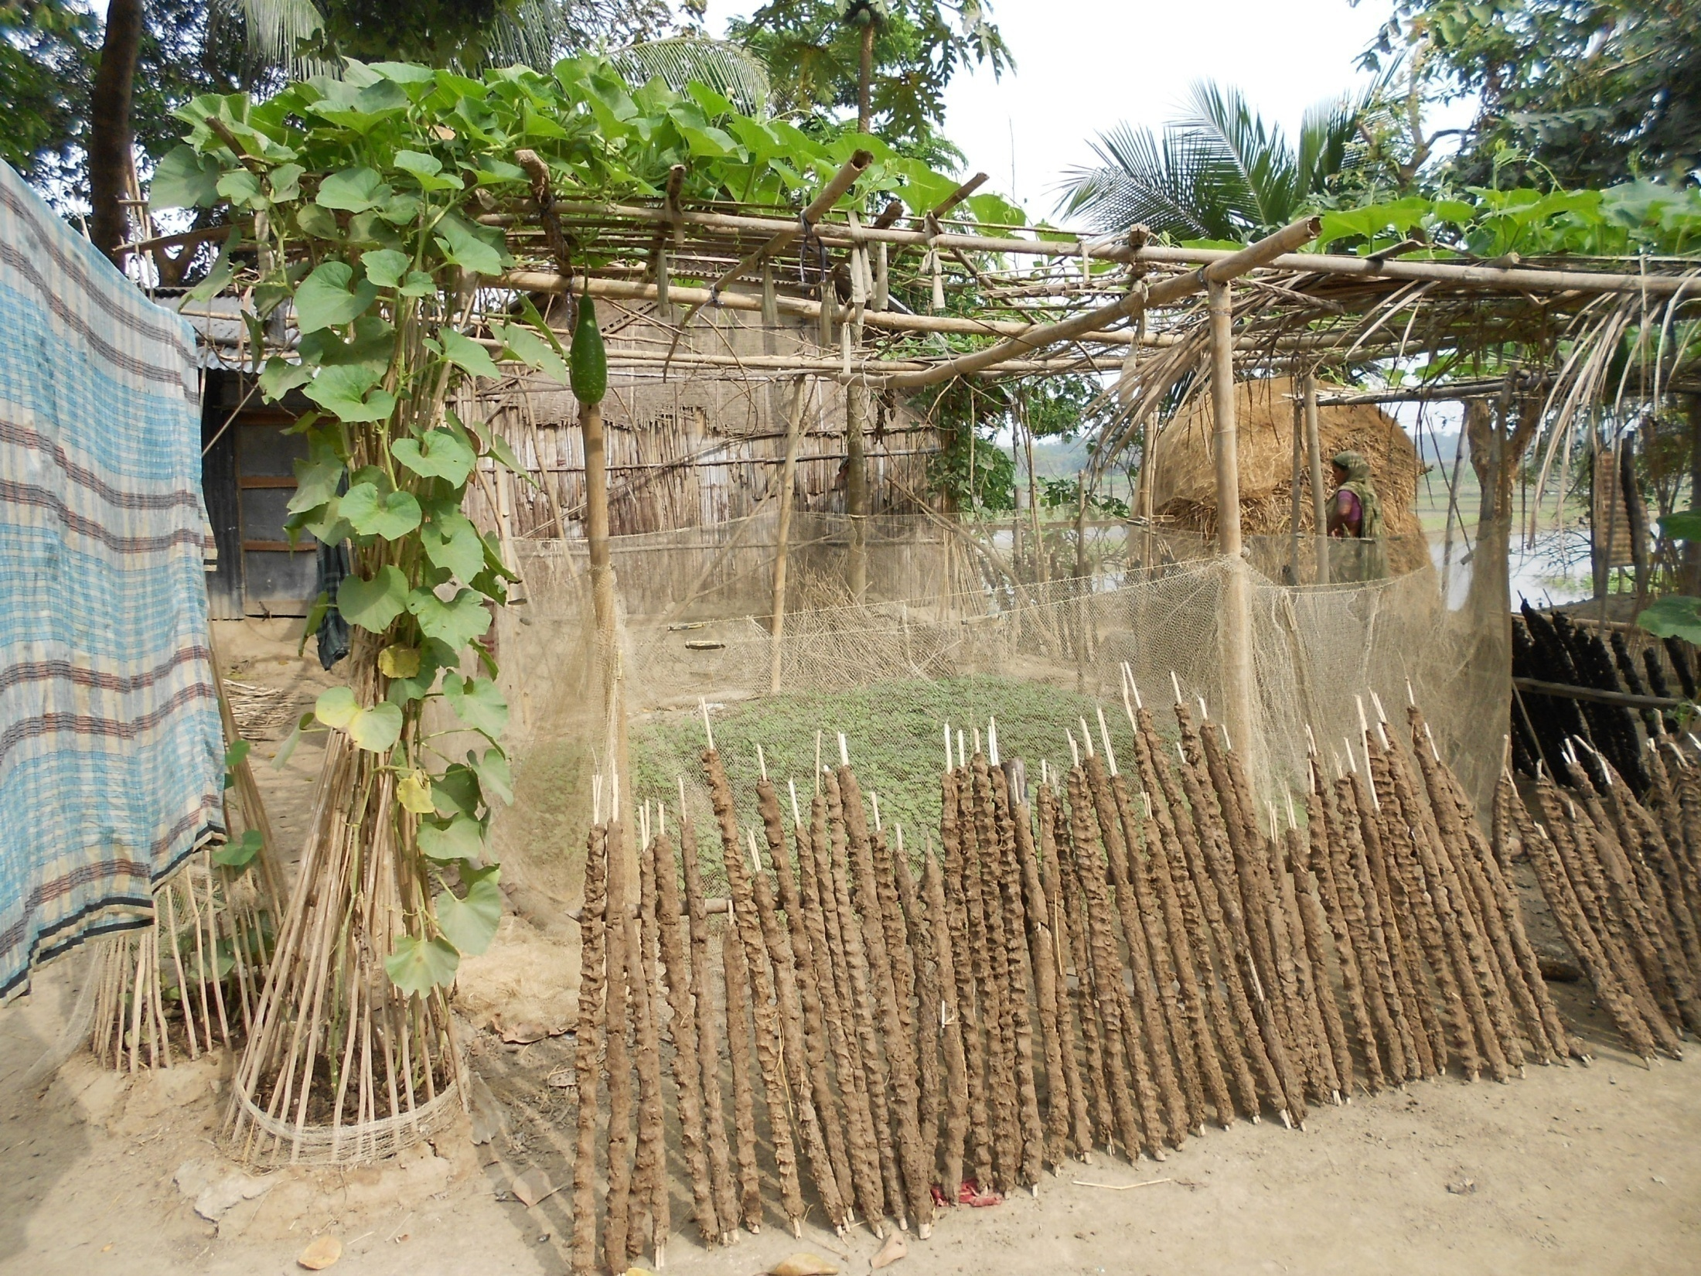
P.C: Sharmind Neelormi

Slide 5
Recognizing women’s economic, social and political achievements in Bangladesh.
with the ethos of celebration as well as with the objective to highlight some of the challenges facing women globally and nationally and to discuss the way forward for a gender-equal and inclusive society.
Interactions/dialogues with different stakeholders. with this, certain values and messages involving gender equality and women rights are relayed.
Security
Economic Participation and opportunities
Euucational attainment
Health and safety
Institutional support
Sex Disaggregated data
Investment
Position within family and society

Slide 6
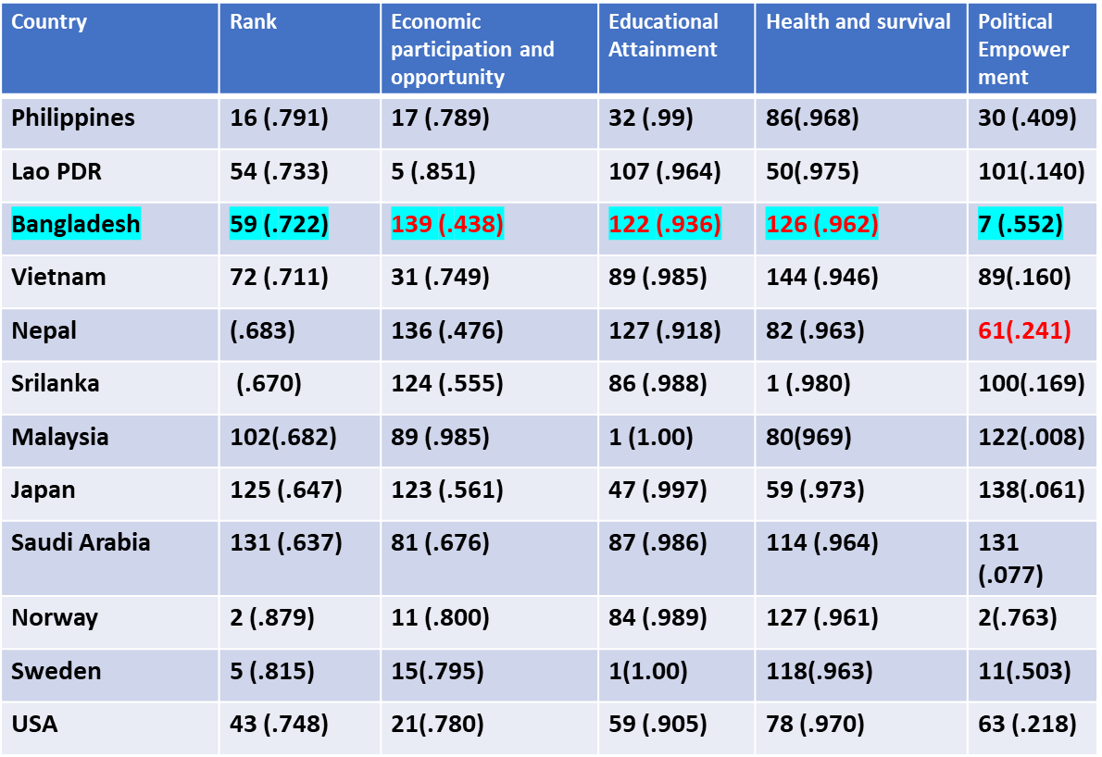
Gender Gap Index
Economic Growth Does NOT autonomously ensure Gender Equality
World Economic Forum: 2023

Slide 7
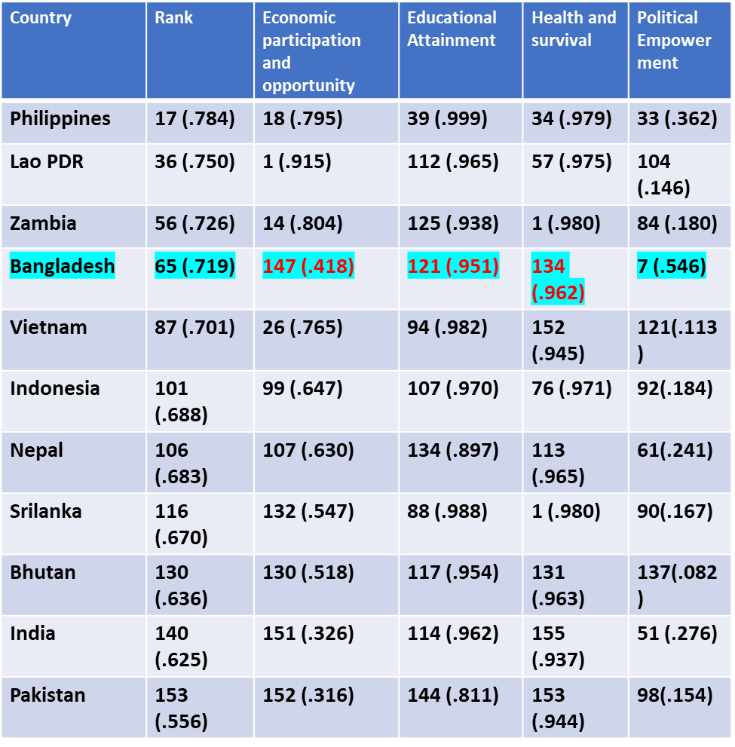
Gender Gap Index
Lower Middle Income Economy Countries
World Economic Forum: 2021

Slide 8
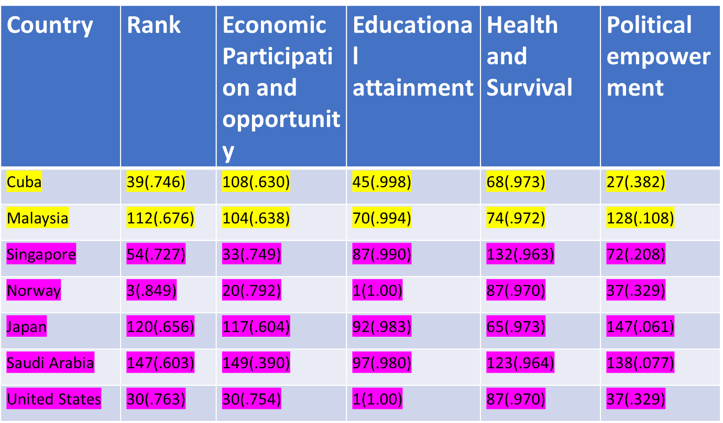

Slide 9
Security
violence against women is traditionally perceived as a private issue — a matter between husband and wide that should remain behind close doors, without state intervention.
Bangladesh: Proportion of ever married women experiencing partner physical and/or sexual violence during lefetime
Physical Violence: 49.6%
Sexual violence: 27.3%
Physican and sexual violence: 54.2%
Lifetime Non-Partner Sexual Violence : 3 %
Child Marriage :58.6
Source: BBS, 2018
Vietnam
Lifetime Physical and/or Sexual Intimate Partner Violence :34 %
Lifetime Non-Partner Sexual Violence : 3 %
Child Marriage :11 %
Norway
Lifetime Physical and/or Sexual Intimate Partner Violence :27 %

Slide 10
Economics is “the study of men as they live and think and move in the ordinary business of life”……. Alfred Marshall
Marshall’s casual allusion to “men” captures what feminist economists believe is the first big problem with economics. This is reflected in how GDP is measured. Wage labour is included; unpaid work at home is not.
The system of measuring GDP was designed by men to keep women “in their place”……Marilyn Waring’s book If Women Counted, 1988
Not only is this way of measuring GDP arbitrary (care is included in “production” when paid for on the market, but not when supplied informally), but because women contribute the bulk of care around the world, it also systematically undervalues their contribution to society.

Slide 11
Julie Nelson, a feminist economist, writes in the Journal of Economic Perspectives that “many readers may have discovered that they are already doing 'feminist economics' in some ways, although they have preferred to think of themselves as just doing 'good economics'”. Indeed, feminist economists wish they lived in a world where the label need not exist.
To be a feminist is simply to believe that everybody should be treated equally, regardless of sex. It means you think that there should be equality of the sexes economically, socially, politically and personally. When you put it like that, it’s surely difficult for anybody to deny being a feminist. But for such a simple concept, it is often dramatically misunderstood.
Perhaps the most common objection to feminism is the argument that it is unnecessary, because equality has already been achieved. This idea feeds into the common stereotype of feminists as angry, man-hating witches, who must be overreacting since there is no real problem to solve.

Slide 12
Gender equality' means equal outcomes for women, men and gender-diverse people. 'Gender equity' is the process to achieve gender equality. Gender equity recognises that women and gender-diverse people are not in the same 'starting position' as men. This is because of historical and social disadvantages.
Equality means that we treat everyone equally - each person or group of people is given the same resources and opportunities. Equity means that we provide resources and opportunities that fit the specific needs or circumstances of that person or group, and in that way, we can reach an equal outcome.

Slide 13
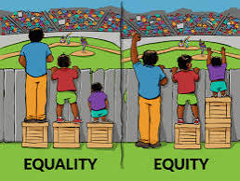

Slide 14
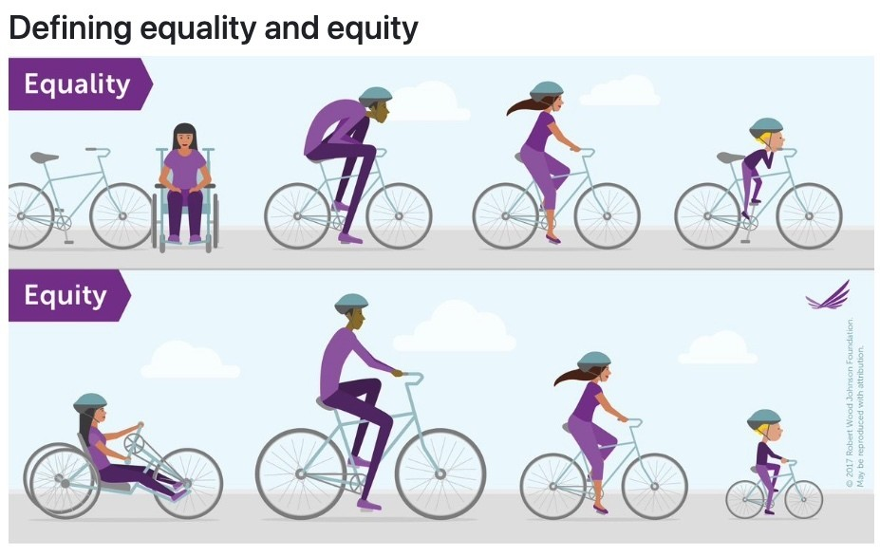

Slide 15
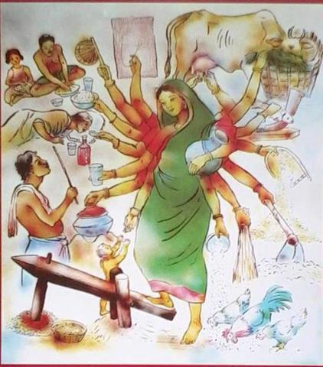
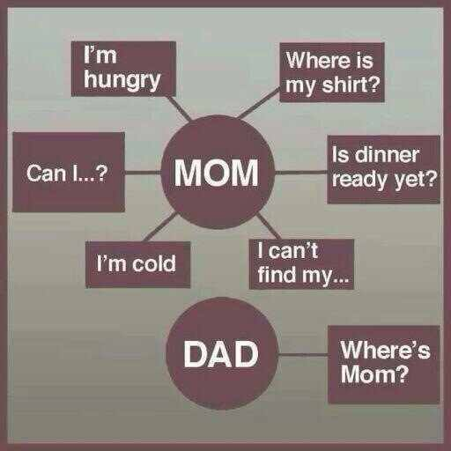
Perception towards Women

Slide 16
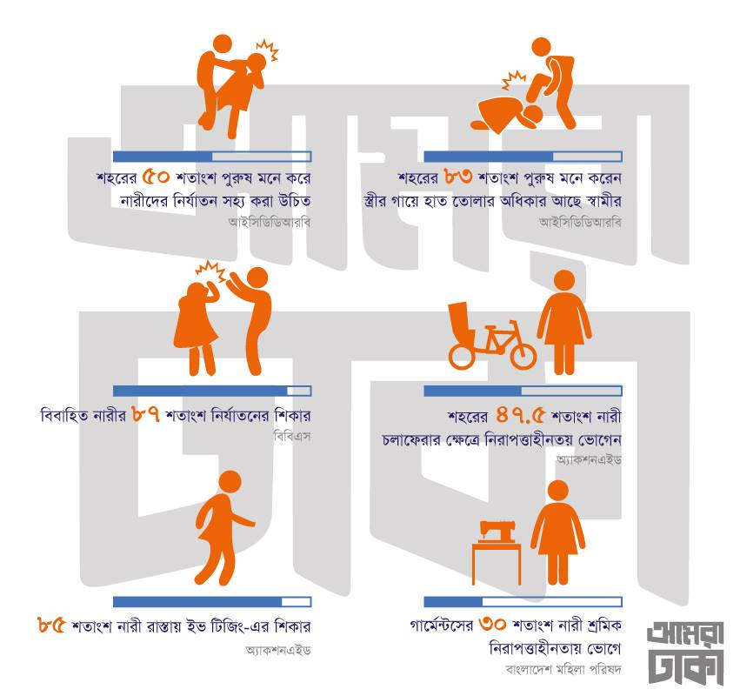

Slide 17
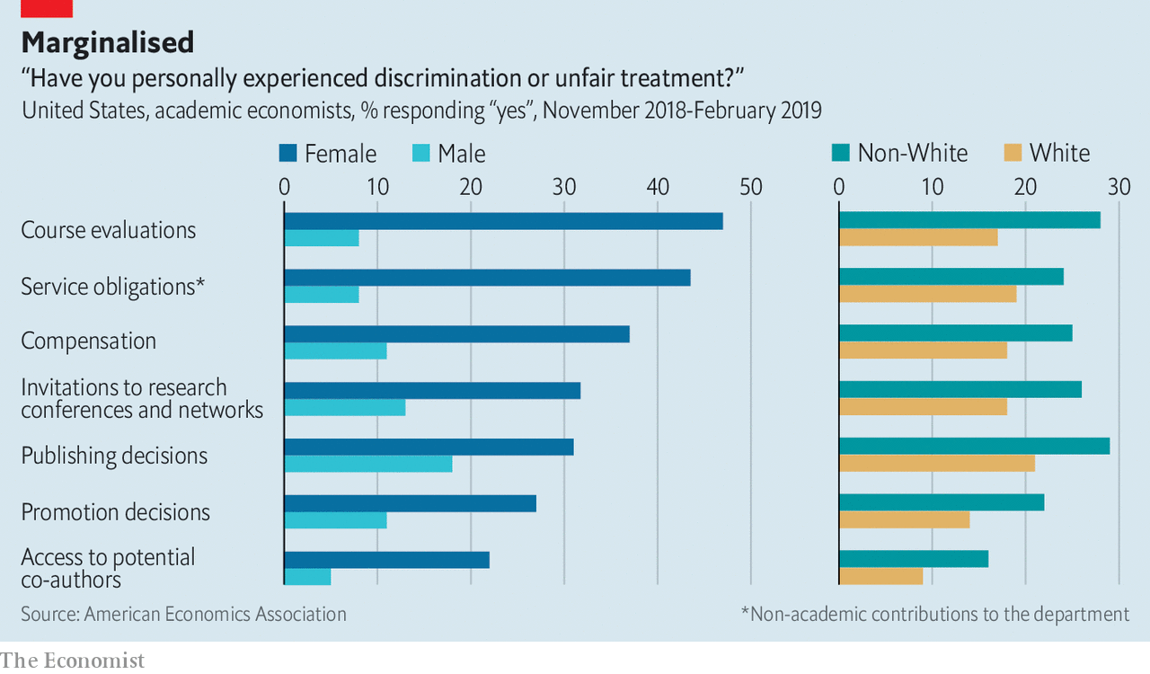

Slide 18
The easiest place to begin is by disproving the notion that gender inequality no longer exists. This is simple enough. Globally, according to the United Nations, at least one in three women is beaten, coerced into sex or otherwise abused by an intimate partner in the course of her lifetime.
In 2016, a UNESCO report estimated that over 130m girls worldwide were out of school.
And campaign group Girls Not Brides reports that each year 12m girls are married before the age of 18.
In Britain, official analysis from the Crime Survey of England and Wales revealed that in the 12 months leading up to March 2017 over 510,000 women experienced some type of sexual assault, including an estimated 144,000 who experienced rape or an attempted rape or assault by penetration. A quarter of women and one in two disabled women in Britain experience domestic violence in their lifetime. Almost a third of 16-18 year old girls report experiencing unwanted sexual touching at school.

Slide 19
Some sceptics will argue that feminism remains problematic because its true objective is not to achieve equality, but to advantage women at all costs, to the detriment of men. Many fear that focusing on women’s rights means neglecting men’s problems, such as the high male suicide rate.
The tragically high male suicide rate, for example, cannot be divorced from the fact that men are far less likely than women to seek support for mental health problems. When we bring men up in a world that teaches them it’s not manly to talk about their feelings, we damage them terribly.
They are two sides of a coin. In this case, the other side is the common notion that women are over-emotional, hormonal and hysterical; a cliché which disadvantages women in the workplace. Feminists are eager to dismantle these stereotypes, in all their forms. So tackling gender inequality at its root, as feminists seek to do, would help everybody, regardless of sex.

Slide 20
“There need not be equal numbers of men and women in nursing and engineering if the talents and interests of men and women differ, for instance.”
The trouble is that this makes unproven assumptions about biological determinism. It is very easy to say that girls simply are not as interested in maths and technology; that women just have no drive to be business leaders; or, as one commenter put it, that: “women are just not that interested.” But it could just as easily be argued that girls’ school subject choices or women’s job applications are heavily influenced by the gender stereotypes that bombard us from childhood.

Slide 21
The world of work
Gender differences in laws affect both developing and developed economies, and women in all regions. Globally, over 2.7 billion women are legally restricted from having the same choice of jobs as men. Of 189 economies assessed in 2018, 104 economies still have laws preventing women from working in specific jobs, 59 economies have no laws on sexual harassment in the workplace, and in 18 economies, husbands can legally prevent their wives from working.(World Bank, Women, Business and the Law 2018. (Washington, D.C., 2018).
Women remain less likely to participate in the labour market than menaround the world. Labour force participation rate for women aged 25-54 is 63 per cent compared to 94 per cent for men. When including younger (aged 15 years and up) and older women (aged 55 and up) , in 2018 women’s global labour force participation rate is event lower at 48.5 per cent, 26.5 percentage points below that of men. (International Labour Organization (ILO), World Employment and Social Outlook: Trends for Women 2018: Global Snapshot (Geneva, 2018).

Slide 22
The world of work
Women are more likely to be unemployed than men. In 2017, global unemployment rates for men and women stood at 5.5 per cent and 6.2 per cent respectively. (International Labour Organization (ILO), World Employment and Social Outlook: Trends for Women 2018: Global Snapshot (Geneva, 2018).
Women are over-represented in informal and vulnerable employment. Women are more than twice as likely than men to be contributing family workers. (International Labour Organization (ILO), World Employment and Social Outlook: Trends for Women 2018: Global Snapshot (Geneva, 2018).
Globally, women are paid less than men. The gender wage gap is estimated to be 23 per cent. This means that women earn 77 per cent of what men earn, though these figures understate the real extent of gender pay gaps, particularly in developing countries where informal self-employment is prevalent. (ILO, Women and men in the informal economy: A statistical picture, third edition ,Geneva, 2018).
Women bear disproportionate responsibility for unpaid care and domestic work. Women tend to spend around 2.5 times more time on unpaid care and domestic work than men. (UN Women, Turning Promises into Action: Gender Equality in the 2030 Agenda for Sustainable Development (New York, 2018)

Slide 23
The world of work
Unpaid care work is essential to the functioning of the economy,but often goes uncounted and unrecognized. It is estimated that if women’s unpaid work were assigned a monetary value, it would constitute between 10 per cent and 39 per cent of GDP. (Diane Elson, Labor markets as gendered institutions: Equality, efficiency and empowerment issues, World Development, vol. 27, No. 3, pp. 611–627 (1999).
Women are less likely than men to have access to financial institutions or have a bank account. While 65 per cent of men report having an account at a formal financial institution, only 58 per cent of women do worldwide. (ILO, Women at Work: Trends 2016 (Geneva, 2016).
The digital divide remains a gendered one: most of the 3.9 billion people who are offline are in rural areas, poorer, less educated and tend to be women and girls.
Women are less likely to be entrepreneurs and face more disadvantages starting businesses: In 40% of economies, women’s early stage entrepreneurial activity is half or less than half of that of men’s. (Global Entrepreneurship Monitor (2017). GEM 2016/2017 Women’s Entrepreneurship Report. Women’s Entrepreneurship Report. )

Slide 24
The world of work
Women are constrained from achieving the highest leadership positions: Only 5% of Fortune 500 CEOs are Women. Cheryl. (2014). Women CEOs of the S&P 500
Violence and harassment in the world of work affects women regardless of age, location, income or social status. The economic costs – a refelction of the human and social costs – to the global economy of discriminatory social institutions and violence against women is estimated to be approximately USD 12 trillion annually. McKinsey & Company, The Power of Parity: How advancing aomen’s equality can add $12 trillion to global growth (2015).

Slide 25
“legal subordination of one sex to the other”………. John Stuart Mill (The Subjection of women, 1869)
In a series of papers in the late 1980s and early 1990s, Amartya Sen coined the phrase 'missing women' to refer to the number of females that have died as a result of discriminatory treatment in the access to health und nutrition in parts of the developing world. He estimated then that the number of missing women was about 100 million.
I do not wish them [women] to have power over men; but over themselves.
Mary Wollstonecraft, A Vindication of the Rights of Woman, 1792

Slide 26
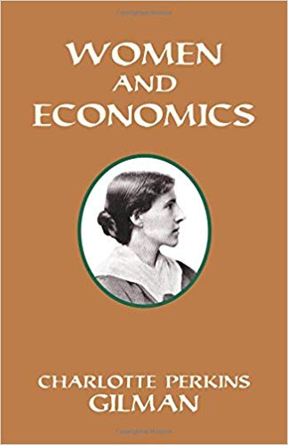

Slide 27

Smith coined the term “ the invisible hand” been the one that put the dinner on his table every night for his entire life—his mother’s, whose efforts and labor were uncounted in his equations and went uncompensated. that has become so widespread in economics. But, it turns out the real invisible hand may have
The field of economics is built around the ideal of “economic man,” an independent, rational being that always acts in his own self-interest.

Slide 28
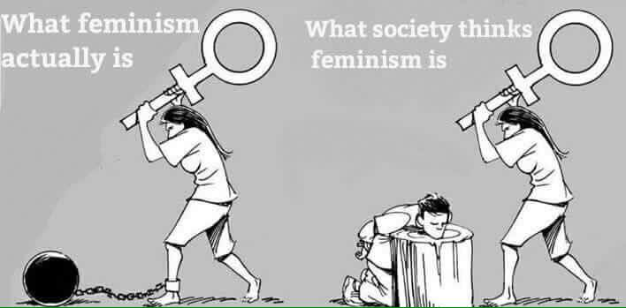

Slide 29
Women in Rural Economy: Bangladesh context
Sharmind Neelormi
Department of Economics
Jahangirnagar University
neelormi1@yahoo.com

Slide 30
P.C: Sharmind Neelormi

Slide 31
Gender Budget
What is a pro-women/girls advancement activity?
Access to health care and improved nutrition
Access to public properties and services
Access to education and training
Reduce daily working hours of women
Women’s participation in labour market and income generating activities
Enhance social safety for women and reduce probable vulnerability and risk
Women’s empowerment
Women’s participation in various forums
Ensure safety and free movement for women
Monitoring and evaluation
Increase social status of women
Access to law and justice for women
Information technology for women
Reduce violence and oppression

Slide 32
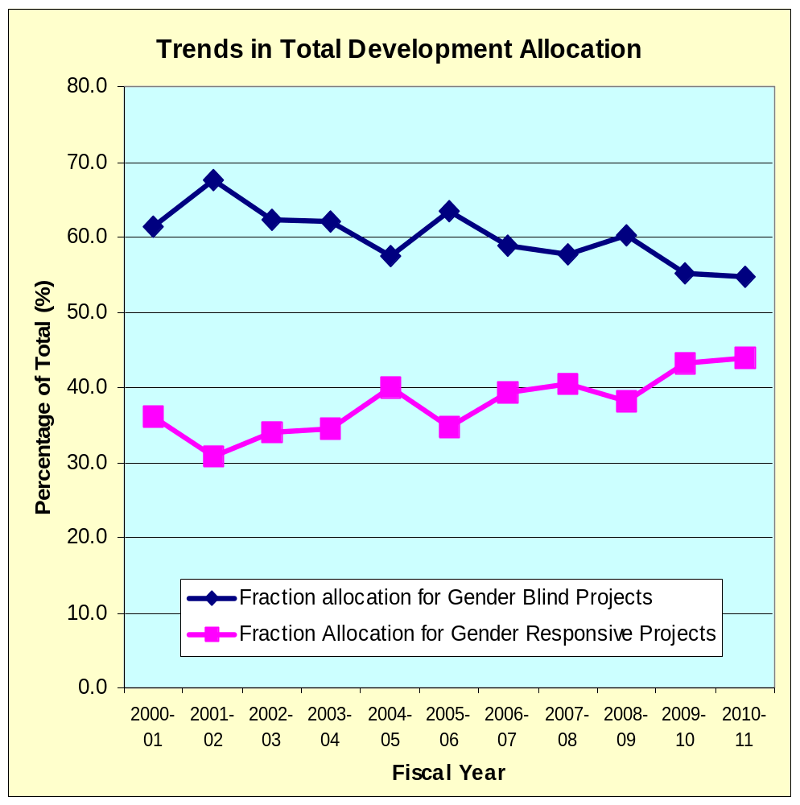
Improving the allocation of resources to women
Relative allocation for gender blind projects has been declining , however the rate lies within the range of 61% to 55% for last decade.
Relative allocation for gender responsive projects has been increasing , however the rate lies within the range of 36% to 44% for last decade

Slide 33
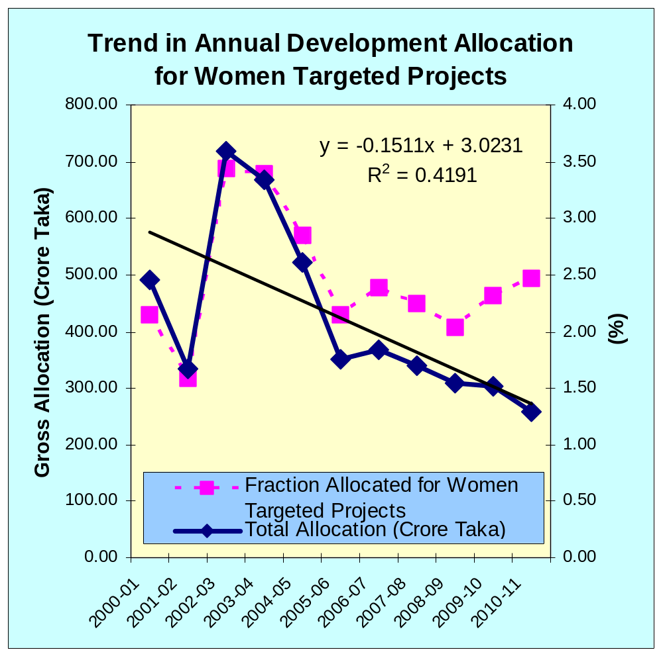
Improving the allocation of resources to women
Relative Allocation for women targeted programs in ADP has been declining sharply for last 9 years
Does it reflect the political commitment of the government?

Slide 34
Key statistics on women’s employment in Bangladesh
S
 | LFS 2016-17 |  |  | LFS 2010 |  |  | LFS 2005
 | National | Rural | Urban | National | Rural | Urban | National | Rural | Urban
Labor Force (Million)
Total | 63.5 | 45.7 | 17.9 | 56.7 | 43.4 | 13.3 | 49.5 | 37.8 | 11.7
Men | 43.5 | 30.7 | 12.9 | 39.5 | 30.2 | 9.3 | 37.3 | 28.5 | 8.9
Women | 20.0 | 15.0 | 5.0 | 17.2 | 13.2 | 4.0 | 12.1 | 9.3 | 2.8
LF Participation Rate (%)
Total | 58.2 | 59.3 | 55.7 | 59.3 | 60.0 | 57.3 | 58.5 | 59.4 | 55.7
Men | 80.5 | 80.3 | 81.0 | 82.5 | 83.3 | 80.2 | 86.8 | 88.0 | 83.2
Women | 36.3 | 38.6 | 31.0 | 36.0 | 36.4 | 34.5 | 29.2 | 29.8 | 27.4
Employed population (million)
Total | 60.8 | 43.9 | 16.9 | 41.7 | 41.7 | 12.4 | 47.4 | 36.1 | 11.3
Men | 42.2 | 29.8 | 12.4 | 29.1 | 29.1 | 8.8 | 36.1 | 27.5 | 8.6
Women | 18.6 | 14.1 | 4.6 | 12.6 | 12.6 | 3.6 | 11.3 | 8.6 | 2.7
Unpaid family worker (million)
Total | 7.2 | 6.4 | 0.8 | 11.8 | 9.7 | 2.1 | 10.3 | 9.2 | 1.1
Men | 1.8 | 1.4 | 0.8 | 2.7 | 2.3 | 0.3 | 3.5 | 3.0 | 0.5
Women | 5.4 | 5.0 | 0.8 | 9.1 | 7.4 | 1.8 | 6.8 | 6.2 | 0.6
source: BBS, 2018

Slide 35
Officially recorded share of women in the labor force is about 31 percent, indicating a relatively lower labor force participation rate by women which is only 36.3 percent (BBS, 2018).
42% of total employment are in Agriculture sector (25.40 million)
Total Employed Female in Agriculture Sector (2015-16) is 11.2 million (14.19 million for male participation); women constitute about 46 per cent of the total farming population (GED, 2015).
63% of employed females are engaged in Agriculture Sector (76.7% in rural areas)
Female employment in agriculture sector constitutes 18.8% employment

Slide 36
Women’s increased participation in the agriculture sector in Bangladesh is noticeable
“Feminization of Agriculture” !!!
Growth Rate of Female Participation in Agriculture Sector, 2005-2015
 | 2005-06 LFS |  |  | 2010 LFS |  |  | 2016-17 LFS
 | Male | Female | Total | Male | Female | Total | Male | Female | Total
 | 15.2 | 7.7 | 22.9 | 15.1 | 10.5 | 25.6 | 13.5 | 11.1 | 24.6
Growth Rate (2005-06 to 2010) |  |  |  | -0.19 | 36.36 | 12.10
Growth Rate (2010-2015) |  |  |  |  |  |  | -11.4 | 5.7 | -4.0
Source: Author’s calculation, based on BBS LFS data (BBS, various years)

Slide 37
 | Year | % of Female | Source
Agricultural Holders | 2008 | 4.6 | Agricultural Census
Agricultural Landowners | 2011-12 | 22.6 | LSMS-Bangladesh Integrated Household Survey(Kieran et al., 2015)
Incidence of Female Agricultural Landowners (sole/joint) | 2011-12 | 8.5 | LSMS-Bangladesh Integrated Household Survey(Kieran et al., 2015)
Agricultural Land Area Owned by Female | 2011-12 | 10.1
Source: FAO Gender and Land Rights Database, 2018
The percentage of female agricultural holders out of total agricultural holders
The share of female agricultural landowners out of total landowners
The incidence of female agricultural landowners as a proportion of the total female adult population
The share of agricultural land area that is owned by women

Slide 38
Informal employment incidence is highest in Agriculture sector (98 percent of the total employment in that sector) (BBS, 2018).
It is critical to note that
93.3 per cent of employed women labors in rural areas are engaged informally;
99.5 percent women employment in agriculture sector falls under informal sector.
About 82 percent of all employed women in rural economy were either own account worker or contributing family worker.

Slide 39
Daily Average Wage Rate of Agricultural Labour (without food and with food, by sex)
Month | Without Food |  | % | With Food |  | %
 | Male | Female |  | Male | Female
January | 309 | 228 | 74 | 287 | 210 | 73
February | 309 | 234 | 75 | 290 | 215 | 74
March | 312 | 234 | 75 | 291 | 219 | 75
April | 331 | 255 | 77 | 309 | 231 | 74
May | 337 | 265 | 79 | 316 | 244 | 77
June | 324 | 254 | 78 | 304 | 238 | 78
July | 328 | 256 | 78 | 307 | 238 | 77
August | 325 | 252 | 78 | 304 | 237 | 77
September | 322 | 248 | 77 | 303 | 233 | 76
October | 319 | 246 | 77 | 300 | 231 | 77
November | 336 | 259 | 77 | 317 | 242 | 76
December | 335 | 259 | 77 | 317 | 241 | 76
Source: BBS, Statistical Year Book, 2016

Slide 40
37.6% of employed females are contributing family workers (4.6% for Males)
% of Population below Poverty Line
 | 2005 |  | 2010 |  | 2016
 | Lower | Upper | Lower | Upper | Lower | Upper
Agriculture, Forestry, Fisheries | 31.5 | 48.2 | 22.2 | 37.0 | 18.2 | 32.0
National | 25.1 | 40.0 | 17.6 | 31.5 | 12.9 | 24.3
Increased Female Participation in Agriculture: Does it indicative of greater well being of the labor force!!!!

Slide 41
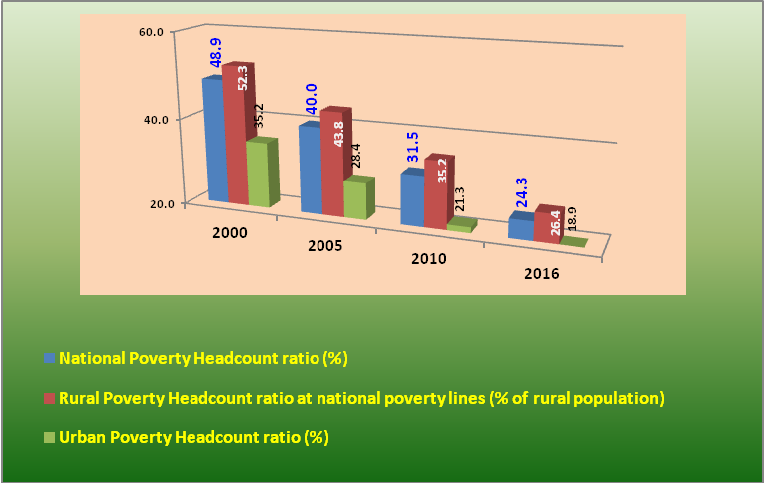
trends in Poverty Incidence by areas. 2000-16
greater depth and larger incidence of poverty in rural areas.

Slide 42
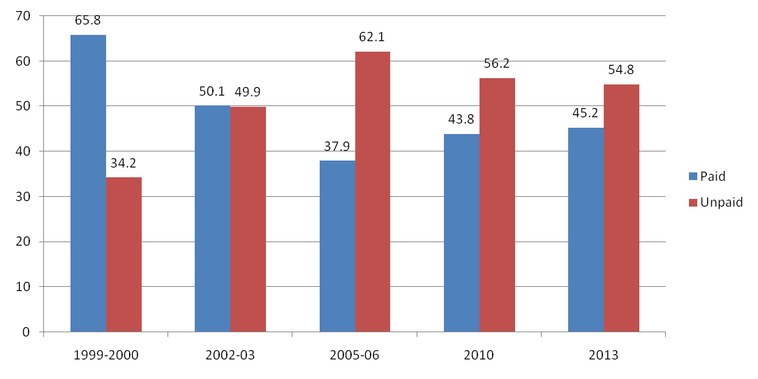
Gainful employment
Women constitute 80.5% of total unpaid labor force.
Among total female employed population, only 45% are paid labors.
Trend of Paid/Unpaid works by Female Lobor Force
Proportion of Female paid labor force has gone down!!!!!

Slide 43
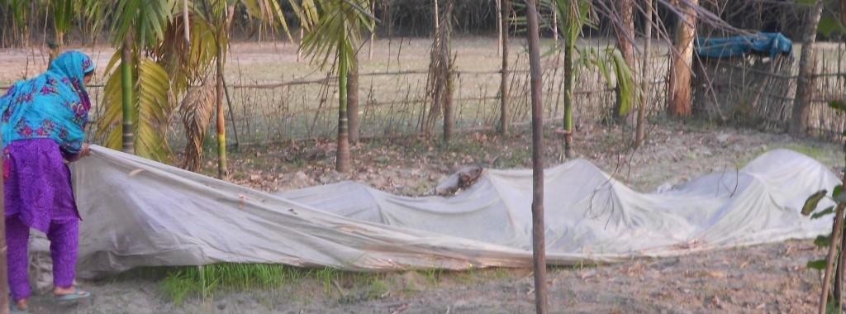
Safeguarding Boro Seedlings from Cold and Dew (labor un accounted for)
P.C: Sharmind Neelormi

Slide 44
Access or Ownership?
Input Assistance Card (Department of Agriculture extension)
Who are FARMERS?
A Farmer has to have
A piece of land with his/her name; and/or
A Lease Agreement with his/her name
Recognition of Female Farmers (Gender Budget, 2015, MoF)
Till Date No of Cards Disbursed : 20.8 million
No Sex Disaggregated data available.

Slide 45
Land Ownership by Sex of Head of Holdings, 1993-2013
Land Ownership | % of Ownership, 2013 | % of Ownership, 1993
Both Sex | 100 | 100
Male | 96.52 | 98
Female | 3.48 | 2.0
FAO, 2014

Slide 46
Khas Land Distribution Policy
Only widowed and abandoned women with an able son are eligible to access Khas Land.

Slide 47
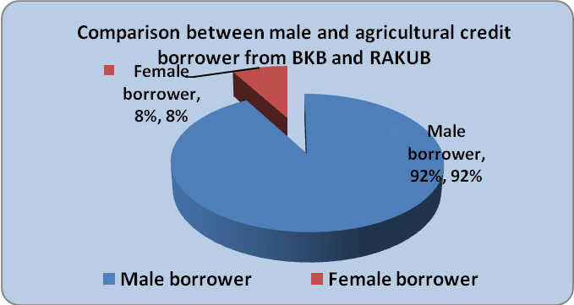

Slide 48
Access to Productive Resources by women
Resources | Mean | Rank Order
Livestock Rearing | 1.92 | 1
Capital | 1.42 | 2
Extension Services & Training | 1.04 | 3
Rural Institutions | 0.99 | 4
Technologies | 0.93 | 4
Land | 0.79 | 6
Production Inputs | 0,62 | 7
Source: International Journal On Rural Studies, 2008

Slide 49
Rural advisory and extension services reach to women in rural areas. However, the significantly larger proportion of this service goes for men; about 33 percent are women among those who received training from the Department of Extension.

Slide 50
Rural women in Bangladesh typically have more limited access to land, education, information, access to credit support, income earning opportunities, essential resources (such as transport like bicycles and motorbikes, improved seeds, fertilizers, equipment, technology) as well as decision-making forums relative to men (Oniang’oand Mukudi, 2002).
This lack of access contributes to yields from women farmers amounting to about 20-30 per cent lower than for men (Begum, 2014) in Bangladesh.

Slide 51
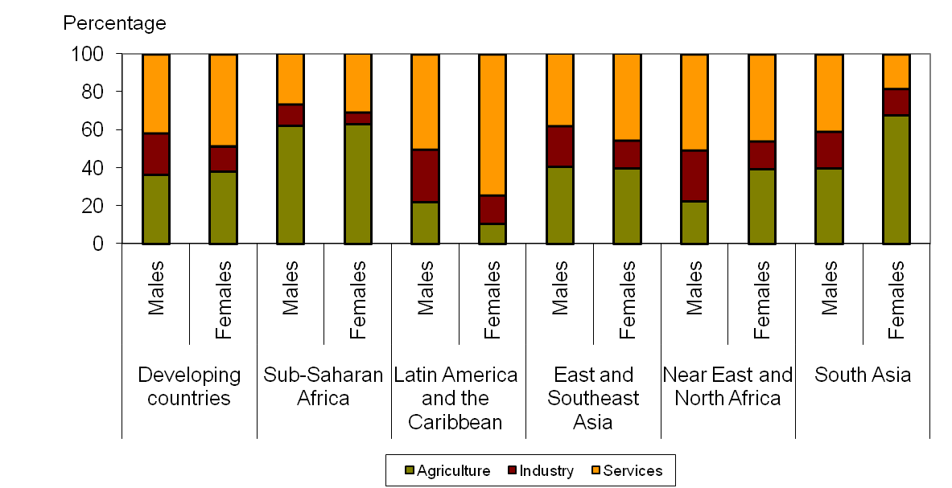
Supporting gender mainstreaming in macroeconomics
Employment of women in Agriculture Sector is absolutely vital
Source: ILO.
Share of employed population by sector and gender

Slide 52
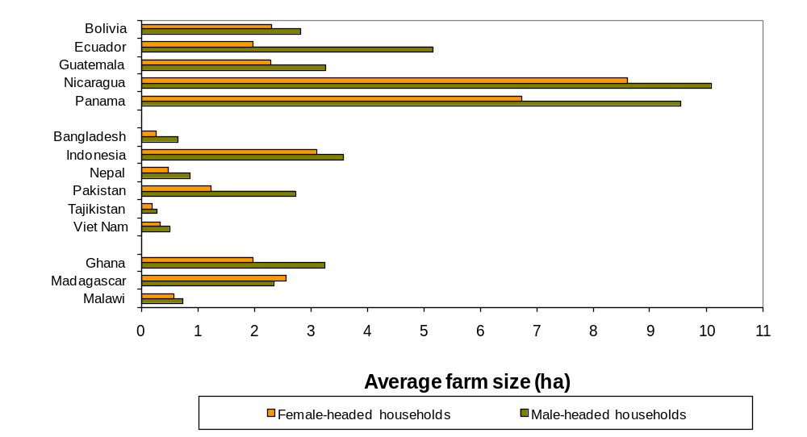
Supporting gender mainstreaming in macroeconomics
But Women owns less land

Slide 53
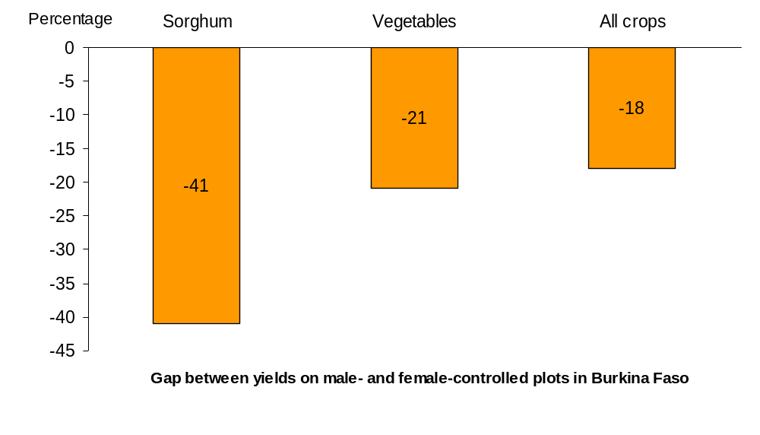
Supporting gender mainstreaming in macroeconomics
Productivity of Female Farmers is relatively lower

Slide 54
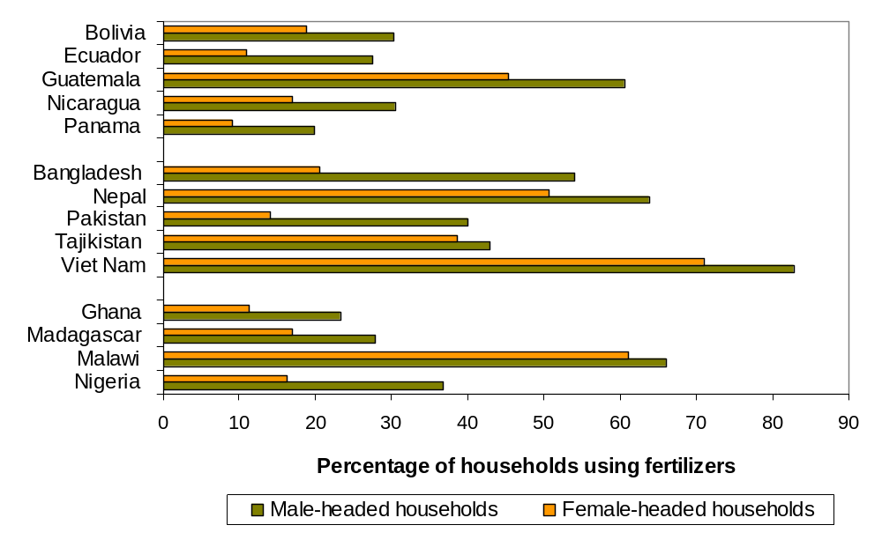
Supporting gender mainstreaming in macroeconomics
……because Women can provide less input

Slide 55
Supporting gender mainstreaming in macroeconomics
Reducing Gender Gap in Agriculture Sector
Gain in terms of productivity
20 to 30% production increase by female farmers
2.5 to 4% increase of production at national level
Gain in terms of food security
Number of hunger will decrease by 12 to 17%
10 to 15 crore people will be out of hunger
Economic and Social Benefit
Better food, nutrition and health
Development of human resources

Slide 56
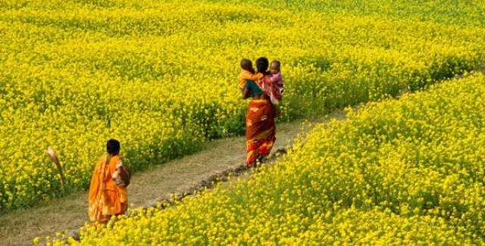
women constitute about 46 % of the total farming population
Women farm workers are paid 26% less than men
4.6 % of farm holdings are headed by women
60 %of employed women are engaged in agriculture sector
Access/ Ownership/ Empowerment
Land right
Credit
Technology
Agricultural input
Market
Extension services
Women have less access to
FAO estimates that closing agricultural gender gap in the world
Increases farm yield by 20-30%
Increases agricultural output by 2.5-4%
Reduce hunger by 12-17%

